Slide 1
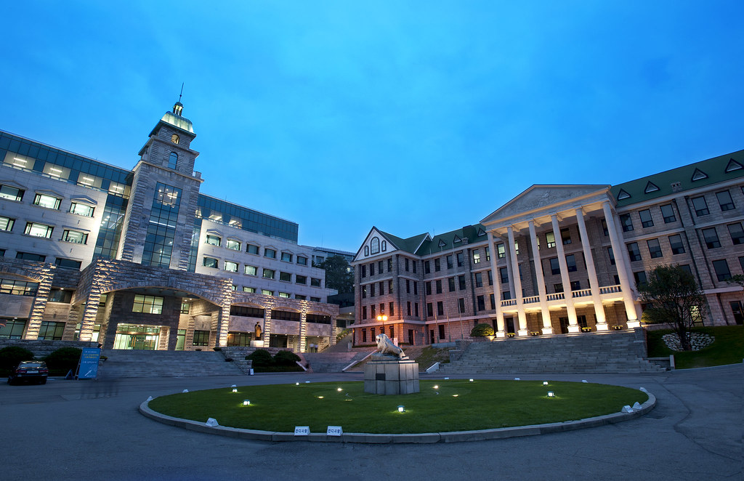
Job Competency Development Plan
Student ID : 2018000337
Name : 장호우

Slide 2
1. My Competency
Strong Competency
View of overall situation
Strong enforcement
Reasons for Strong Competency
Work carefully, earnestly and responsibly.
Examples of Strong Competency
I can be able to follow up the project and make adjustment quickly and properly according to situation.
Weakness
Not good at teamwork
Reasons for Weakness
In my stereotype is that teamwork is inefficient.
Examples of Weakness
Prefer to do it on my own, rather than work with others as a team.

Slide 3
2. My Competency related to Desired Job
Strong Competency related to Desired Job
Hard work
Consistently excellent execution
Courage to take responsibility
Clear goal to do something
Weakness related to Desired Job
Lack of communicators and struggle with relationships.
Too honest with the other person to communicating.

Slide 4
3. Plans for developing the weakness
Specific plan for developing the weakness
In the Short term
Talking to those I trust and respect will help I sort out some problems.
Keep communication open with those I live with.
Take a variety of classes offered by HY-CDP.
Consider the well-being of others.
Take part in group activities, in interpersonal communication in each other, learn from life.

Slide 5
3. Plans for developing the weakness
Specific plan for developing the weakness
In the Medium term
To join clubs during the semesters and to understand the joy and importance of school club activities. In addition, The most importance is learn how to work with others.
To find foreigners chat, participate in English activities, such as English speaking competition, much to teach others to learn how to do well in communication.
Participate in collective activities.

Slide 6
3. Plans for developing the weakness
Specific plan for developing the weakness
In the Long term
The most important things is to learn about communication is appropriate timing and context.
To be a leader, I must learn to rail and not die a thousand deaths.
Taking personal initiative and thinking about how an organization can work differently.
Contributing to society for life to create brilliant.

